Slide 1
Responding to
procurement misconduct
Greenfield Construction Ltd · Board advisory presentation
Bribery Act 2010 · Procurement Act 2023
March 2026
Notes:
My name is Zohaib and Greenfield brought me in after the situation in January to give the Board a clear picture of what they’re dealing with and what the options are. We have no commercial stake in the outcome. Run through: what happened, the legal exposure, three options, and what we recommend.

Slide 2
Who we are and why we're here
OUR ROLE
THE QUESTION
We're independent ethics advisors. Greenfield brought us in after David received the call from Richard Hale on 6 January.
Our job is to give the Board a straight read on the options. That means we'll give you an honest read, even where it's uncomfortable.
We have no commercial interest in the outcome of the tender.
Richard Hale is directly involved in evaluating your live Avondale tender. He has offered confidential scoring data and a competitor's submission in exchange for employing his son.
Accept, stay quiet, or report it?
The Board hasn't responded yet. David made the right call in bringing this here before doing anything. That matters, both legally and practically.
TODAY'S AGENDA
What happened
The legal exposure
Three options, honestly assessed
What we recommend, and why
Notes:
Keep this brief. David made the right call by not responding and bringing this to the Board, it keeps options open and legal. Read the question panel on the right out loud, let it make its impact, then move on.

Slide 3
What happened
WHAT RICHARD OFFERED
WHAT'S AT STAKE
Richard Hale is a senior quantity surveyor at Avondale County Council. He's been a business contact for years, and the Greenfield siblings consider him a friend. He's also directly involved in evaluating your £18.5m health centre tender.
On 6 January he called David telling him that Greenfield is currently second. Harmon Developments is ahead on price and social value. Richard offered to share the full scoring breakdown and Harmon's social value submission. Enough to know exactly what to beat.
In return: a job for his son. 'A favour between friends,' he said. 'This is just how things work.'
This is the largest contract Greenfield has ever pursued. Winning it would sustain 85 jobs over three years, 15 apprenticeships, and mark real progress in the public sector strategy the Board has been building.
Greenfield also invested £2.4m in new equipment on the expectation of contracts like this one.
On the other side of this bid is a deprived community with real health inequalities and a housing shortage. They depend on this process being run fairly.
Notes:
Don't rush this slide. The Board needs to understand the matter before you get to the options. Richard isn’t just beating about the bush, he’s offering specific scores and a competitor's submission. That distinction is what triggers the Bribery Act. On the stakes: the £2.4m investment is real, don't brush past it. On the community: health inequalities, housing shortage are worth saying out loud as this isn't just corporate risk.

Slide 4
The legal picture
BRIBERY ACT 2010
PROCUREMENT ACT 2023
Section 1: offering an advantage to induce improper conduct is a criminal offence. Offering employment to Richard's son in exchange for tender information qualifies.
Section 2: accepting such an advantage is also an offence. Receiving insider data, even without acting on it, could be enough.
Section 7 is a corporate offence: failing to prevent bribery. That exposure exists regardless of who in the company made the call.
Strict liability. Maximum sentence: 10 years. (HM Government, 2010)
Public contracts require fair, open, transparent competition. Council evaluators sharing confidential information with a bidder is prohibited outright. Accepting it makes Greenfield complicit in that breach.
If this surfaces after award: the contract gets voided and Greenfield gets debarred from public procurement. Every future tender, gone.
Richard's disclosure is already unlawful. What Greenfield does next determines whether it becomes Greenfield's problem too. (HM Government, 2023)
Greenfield doesn't need to use the information for liability to arise. Receiving it without reporting could be enough.
Notes:
The Board may not grasp how broad the Bribery Act is. Section 1: the offer of employment doesn't need to be accepted, making the offer is already an offence. Section 2: receiving the insider data in this context can constitute acceptance of an advantage. Section 7: even if David personally declines, the company still faces exposure without demonstrable adequate procedures in place. On the Procurement Act: debarment is the really damaging consequence as Greenfield's entire public sector strategy depends on those contracts. Read the bottom line out loud. PS. Section 7 (the corporate offence) carries an unlimited fine only, not imprisonment.

Slide 5
Three options
Option A — Accept
Option B — Stay quiet
Option C — Decline and report
Could win the £18.5m contract
Sustains 85 jobs in the short term
Criminal offence: Bribery Act ss.1, 2 and 7
Contract voided and debarred from public procurement if discovered
Reputational damage that can't be undone
The exposure exists even if you never use the information
No direct criminal exposure
Friendship with Richard preserved
Leaves a corrupt process running
Silence can look like complicity if this surfaces later
Richard may approach the next bidder
Hard to square with 'building with integrity'
Full legal protection
Consistent with Greenfield's stated values
Public sector pipeline stays intact
Right outcome for the community
Real chance of losing this contract
Short-term financial pressure
Notes:
Don't signal the answer yet, just let them sit with all three. On A: acknowledge the appeal honestly, the contract is significant, but the legal risk is existential, not a technicality. On B: it feels like the safe move but it isn’t, as silence can look like complicity if this surfaces another way, and someone usually talks. On C: the short-term cost is real, don't minimise it. Slides 6 and 7 build the case.

Slide 6
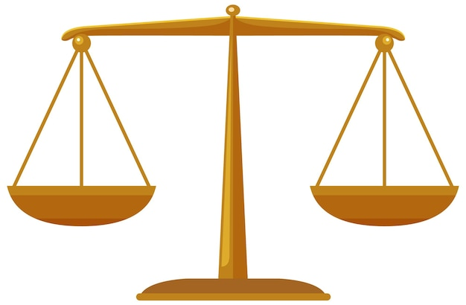
Ethical analysis: utilitarianism
THE FRAMEWORK
APPLIED TO EACH OPTION
Utilitarianism asks one question: which action produces the best outcome for the most people?
Bentham and Mill's answer: the greatest happiness for the greatest number. That means counting all affected parties, not just Greenfield. The right action is the one that produces the most welfare overall.
(Crane and Matten, 2019, pp.103–108)
If you accept: one contract won, 85 jobs in the short term. But if it surfaces, and these things do surface, the costs are enormous. Prosecution, debarment, a reputation built over two decades could potentially be ruined.
If you stay quiet: you avoid direct harm to Greenfield. But the corrupt process keeps running. The community still loses out on a fair competition. It's cleaner than option A but not by much.
If you decline and report: you might lose this contract and that's a real cost. But Greenfield's public sector pipeline stays intact. The community gets a fair process. Richard's conduct stops before it reaches the next bidder.
One caveat, however: this assumes getting caught is a real risk. Deontology doesn't need that assumption.
Notes:
Bentham and Mill - greatest good for the greatest number, counting everyone affected, not just Greenfield. On A: short-term gain detrimental costs if it surfaces. Even statistically it’s not a ‘worthwhile’ risk. On C: lose this contract, keep the pipeline and the reputation. Worth it on the numbers. Name the limitation: a strict utilitarian might calculate differently if detection felt near to zero.

Slide 7
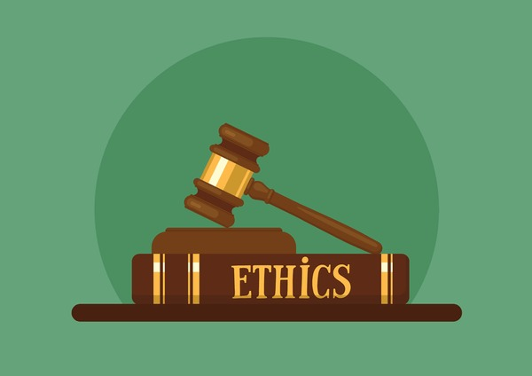
Ethical analysis: deontology
THE FRAMEWORK
APPLIED TO GREENFIELD
Kant's deontological ethics isn't interested in outcomes. An action is right or wrong based on what it is, not what it produces.
Two tests from the categorical imperative:
(i) Universalisability: act only on rules that could apply to everyone
(ii) Humanity: treat people as ends in themselves, not as means to an end
(Fisher and Lovell, 2009, pp.88–95)
Test 1, universalisability. What if every company in a public tender accepted insider information when offered? The entire procurement system could collapse. The rule can't be universalised. For Kant, that settles it, regardless of how likely discovery is.
Test 2, humanity. Richard's offer uses the Council, competing bidders, and the community as instruments/pawns. Accepting makes Greenfield a participant in that. Kant's second formulation rules it out.
'Building with integrity' is a commitment Greenfield made themselves. Carroll (1991) makes the same point: ethical responsibilities constrain how economic goals are pursued. Profit doesn't override them.
On that, Kant and Carroll agree.
Notes:
Unlike utilitarianism, Kant doesn't care about consequences, an action is right or wrong in itself. Test 1: ask them out loud if every company in a public tender took insider information when offered, what happens to procurement? The rule can't be universalised. Test 2: Richard's offer uses the Council, Harmon, and the community as instruments and Kant rules that out. Greenfield's own "building with integrity" commitment carries weight here. Carroll makes the same point: ethical responsibilities sit above economic ones. Key contrast with utilitarianism: this answer doesn't change if the odds of getting caught
were zero.

Slide 8
What we recommend
OUR RECOMMENDATION
Decline Richard Hale's offer and report his conduct to Avondale County Council's monitoring officer. Utilitarianism and deontology point the same way. The table below shows what that means for each stakeholder.
Stakeholder | Their interest | Why Option C works for them
Board and shareholders | Risk management, fiduciary duty | Criminal liability off the table; governance obligations met
Employees (85 staff) | Job security, long term | A sustainable reputation is what secures the next contract, and the one after that
Community | A health centre and housing they actually need | Fair procurement gives them the best contractor, not the one with the best connection
Avondale County Council | Procurement integrity | Early disclosure limits their own legal exposure too
Industry and CIOB | Professional standards | Construction has taken enough reputational hits on procurement.
Richard Hale | Friendship, personal interest | Staying quiet doesn't protect him. If this surfaces another way, Greenfield's silence is a problem. Early intervention may limit the damage to him.
Notes:
State the recommendation clearly. Two different frameworks reached the same answer by different routes, which is worth pointing out so it doesn't look like one theory being cherry-picked. On employees: 85 jobs on this project isn't the same as long-term security. On the community: health inequalities and housing, say it directly. On Richard: this is the awkward part; acknowledge it as staying quiet doesn't actually protect him. Early disclosure is probably better for him too. Leave the Board with four actions: David writes to Richard in writing
today; legal counsel on disclosure obligations; report to the monitoring officer and also a reminder to build defence for s.7.

Slide 9
Conclusion
Your next contract depends on
how you handle this one.
Both frameworks lead to the same answer.
The law is clear too. But the ethical case doesn't depend on it.
Greenfield's public sector strategy runs on its reputation. One contract is not worth the thing that gets you contracts.
Decline in writing. Get legal counsel on the phone. Report to the Council's monitoring officer.
Notes:
No hedging. Reputation is what gets Greenfield back in the room for the next contract, this one isn't worth trading it. Walk through the logic briefly: A means prosecution and debarment; B feels safer but someone usually talks; C is the only one that holds up. Leave them with the four actions from the previous slide and invite any questions.

Slide 10
REFERENCES
Carroll, A.B. (1991) 'The Pyramid of Corporate Social Responsibility: Toward the Moral Management of Organizational Stakeholders', Business Horizons, 34(4), pp. 39–48.
Crane, A., Matten, D., Glozer, S. and Spence, L. (2019) Business Ethics: Managing Corporate Citizenship and Sustainability in the Age of Globalization.
5th edn. Oxford: Oxford University PressFisher, C. and Lovell, A. (2009) Business Ethics and Values: Individual, Corporate and International Perspectives. 3rd edn. Harlow: Pearson Education.
Freeman, R.E. (1984) Strategic Management: A Stakeholder Approach. Boston: Pitman.
HM Government (2010) Bribery Act 2010. London: The Stationery Office. Available at: https://www.legislation.gov.uk/ukpga/2010/23/contents (Accessed: 19 March 2026).
HM Government (2023) Procurement Act 2023. London: The Stationery Office. Available at: https://www.legislation.gov.uk/ukpga/2023/54/contents (Accessed: 19 March 2026).

